Slide 1
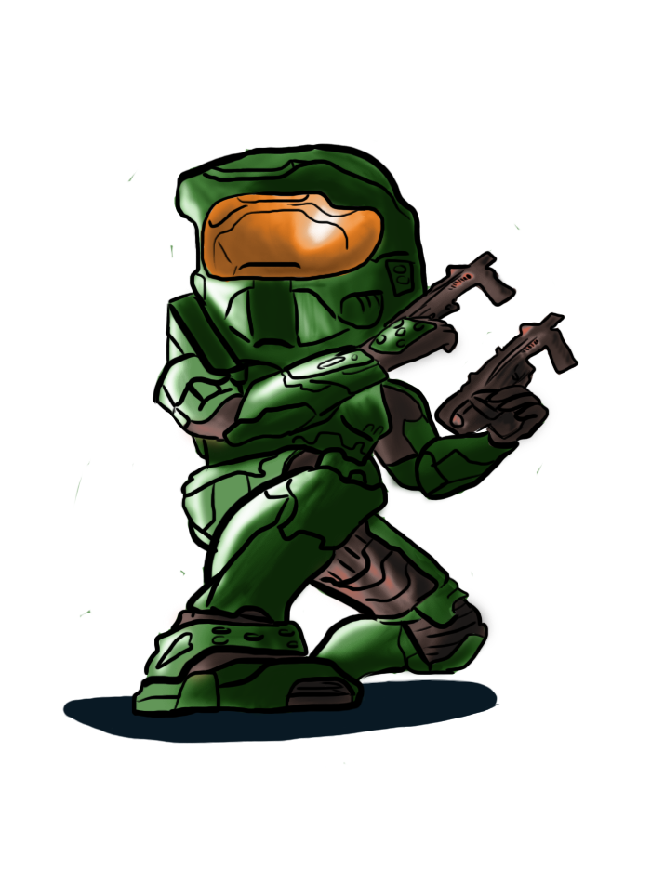

Success of Video Games
Won Yida

Slide 2
Why Video Games?
$108.9 Bn
Global video games market
Sales in 2017!
Notes:
Over 40 years old now, since the 80s.
Targeting a wider and wider age bracket as time goes by.
Rapidly growing market.
What games can sell and what makes games sell is important.

Slide 3
The Problem
What kind of games are successful?
What factors affect success?
*Useful information for game distributors.*
Notes:
This are the questions we’ll be concerned about.
So if we’re say, a game distributorship or game store, and we want to find out what games to stock or offer, this would be useful information.

Slide 4
Objectives
*Using Machine Learning Models*
Predict whether a game will be successful.
Identify important factors
Evaluate model performance
Notes:
Just read

Slide 5

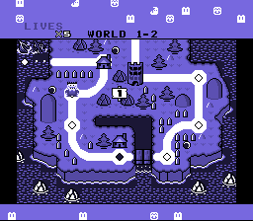

The Game Plan
Gather Data
Evaluate Model
Exploratory Data Analysis
Apply Model
Engineer Features
Notes:
So when it comes to machine learning project, this is the rough basic outline. First we……….

Slide 6
1.
Gathering Data
Notes:
I had to scrape my own data for this project.
Data is scraped from the website www.vgchartz.com. Contains global weekly sales data, week by week,
-not only can see total sales, but sales over time as well.
Using tools:
Python
Beautiful Soup is a Python package for parsing HTML and XML documents.

Slide 7

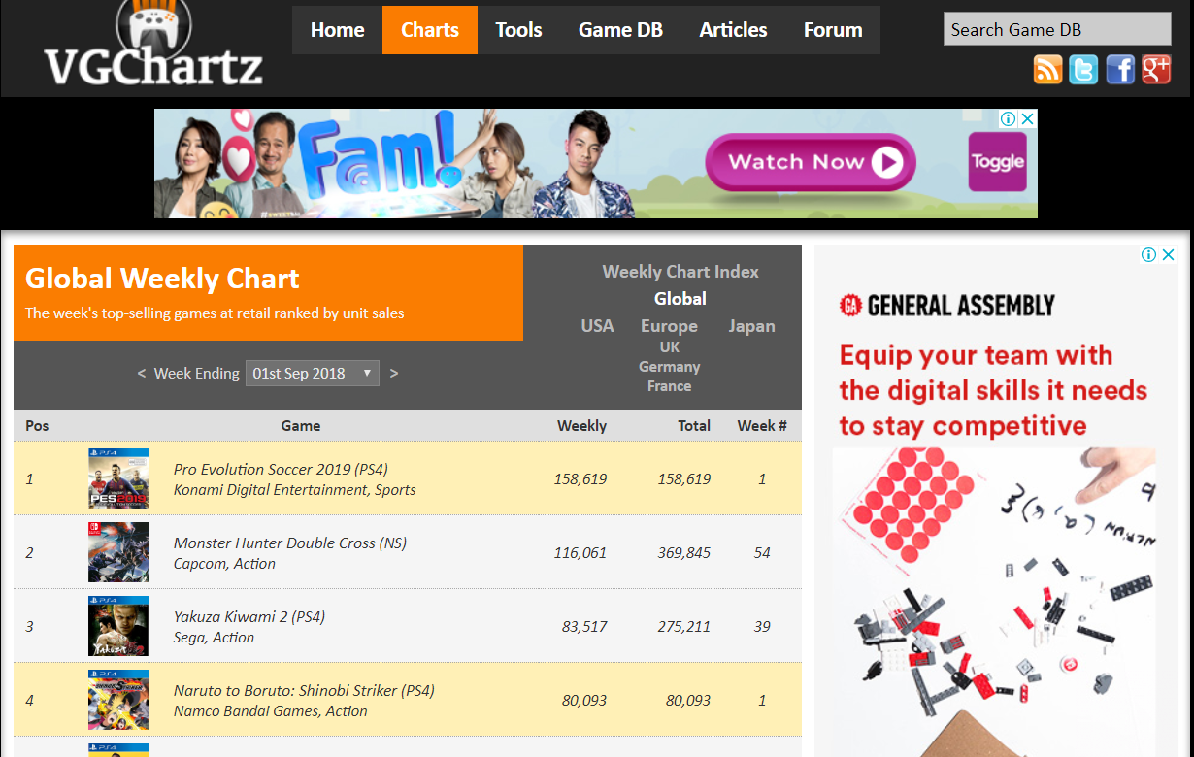

Gathering Data - Webscraping
Data scraped from www.vgchartz.com
Notes:
I had to scrape my own data for this project.
Data is scraped from the website www.vgchartz.com. Contains global weekly sales data, week by week,
-not only can see total sales, but sales over time as well.
Using tools:
Python
Beautiful Soup is a Python package for parsing HTML and XML documents.

Slide 8
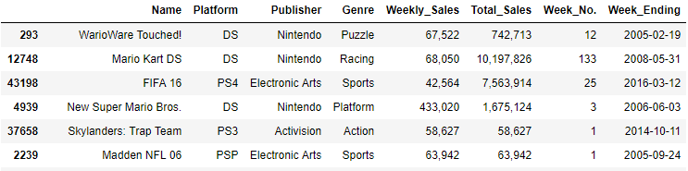
The Data
Weekly Sales Data
Games from 2004 - 2018
Unit Sales numbers
Notes:
These are the features I managed to scrape from the website. There are basic features such as….
Note that the data set will have repeat entries for the games due to different week numbers.
Also, note that these numbers are unit sales. Critic scores were scraped separately and joined later
COMMENTS: Probably can split different slides and talk abt each feature

Slide 9
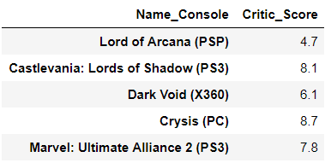
The Data
Averaged scores from various review websites
Scaled from 0 - 10
Notes:
These are the features I managed to scrape from the website. There are basic features such as….
Note that the data set will have repeat entries for the games due to different week numbers.
Also, note that these numbers are unit sales. Critic scores were scraped separately and joined later
COMMENTS: Probably can split different slides and talk abt each feature

Slide 10
2.
Exploratory Data Analysis (EDA)

Slide 11


2. EDA - Focus
Identify distributions
Release Date
Genre
Publisher
Platform
Typical life cycle of game sales
Notes:
So the main point of EDA is to get a basic feel of the data, see if we can identify any trends. We’ll be focusing on the major features:......etc
Based on the weekly sales data we’ll take a look at the typical life cycle of the game sales

Slide 12
2. EDA - Dataset Limitations
Dataset is based on unit sales.
Not accounted for:
Revenue vs Cost/Profit Margin
DLCs
Effects of competition
Missing data - Most sales data are confidential.
Notes:
Collection of data is already based on assumptions
Emphasis on how raw the data is. I had to do a lot of pre-processing and scrape additional data. It’s not like Kaggle competition projects where dataset prepared and all features included.
-Data is based on unit sales
-Definition of success is vague: cost of development vs total revenue from the games not considered
Expensive games or low cost games can make up for low unit sales
-Does not account for new trend of DLCs.
Results are skewed towards games with huge customer base by famous publishers.
-Difficulty: In obtaining Data additional data, since all the data is scraped online.
COMMENTS: Move to the start to prepare the audience before setting expectations

Slide 13
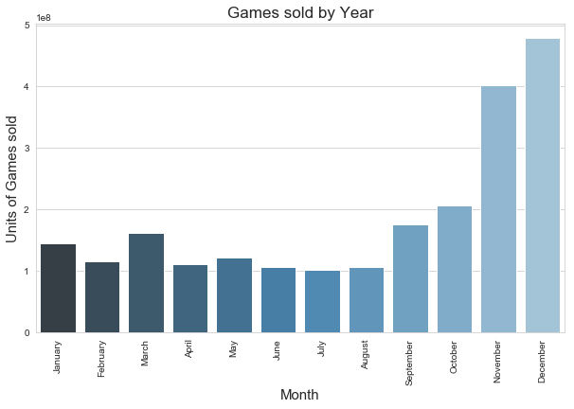
Notes:
Seasonal

Slide 14
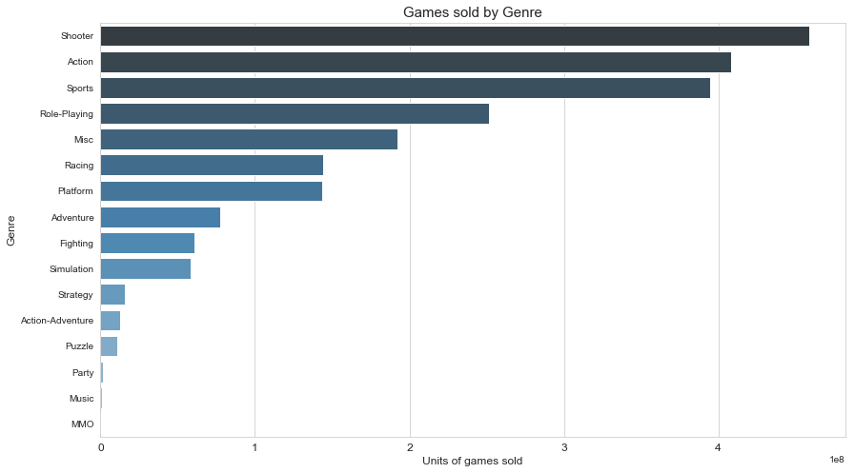

Slide 15
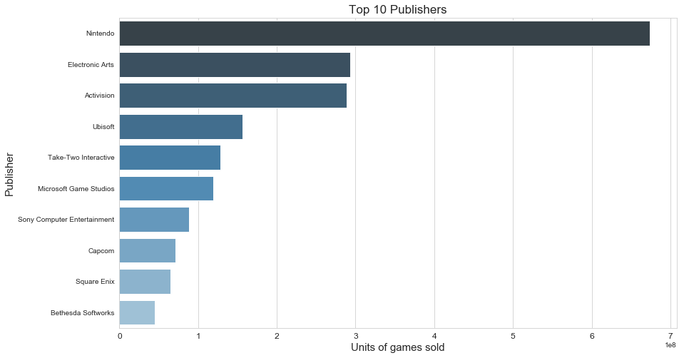

Slide 16
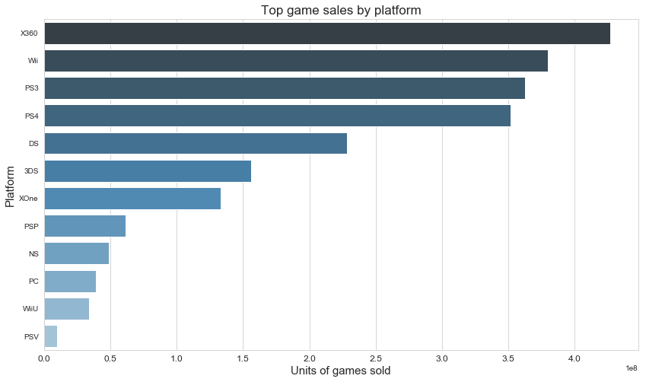

Slide 17
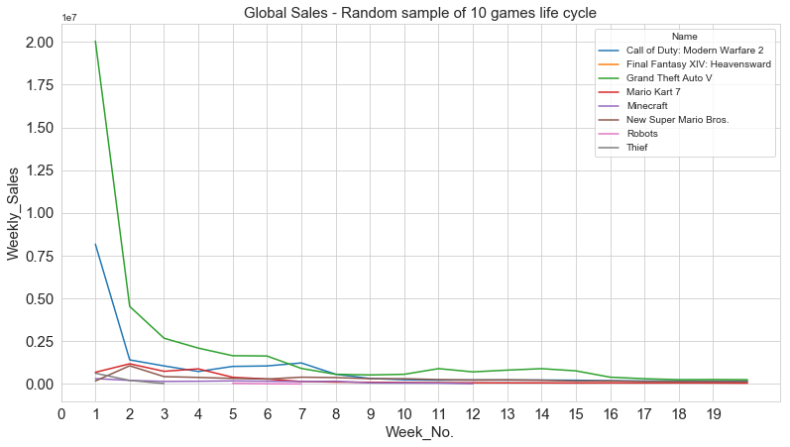
Week 1

Slide 18
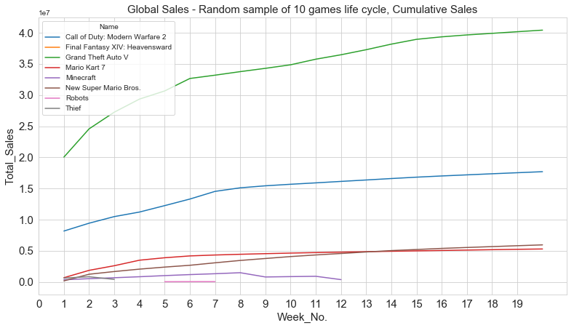
Week 6

Slide 19
3.
Engineering Features

Slide 20
3. Engineering Features
Predictor Features:
Included:
Platform
Publisher
Genre
Release Month
Critic Scores
Excluded:
Name/Title
Release Year

Slide 21


3. Engineering Features
Target Feature:
Above 1,000,000 sales after 6 weeks.
Snapshot of sales figures after 6 weeks.
Notes:
So straight away it becomes a classification problem.
How did i handle inbalanced data? I redefined the evaluation metric

Slide 22
4.
Applying Models

Slide 23
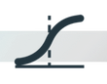
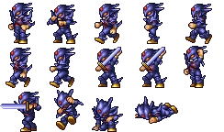
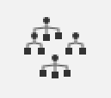

Fitting models
Results
Train-Test Split
Logistic Regression
Training Set: 2004 - 2016
Test Set: 2017 - 2018
Successful
(1)
Random Forest
Unsuccessful
(0)
Notes:
I used 3 models to predict whether the games are successful. I won’t go into much detail on how they work but basically they’re binary classification models, meaning they will output a 1 when the game is predicted to by successful, and a 0 when it’s predicted to be unsuccessful. The models are also able to tell me the feature importance for each feature in determining the probability that a game is successful.

Slide 24
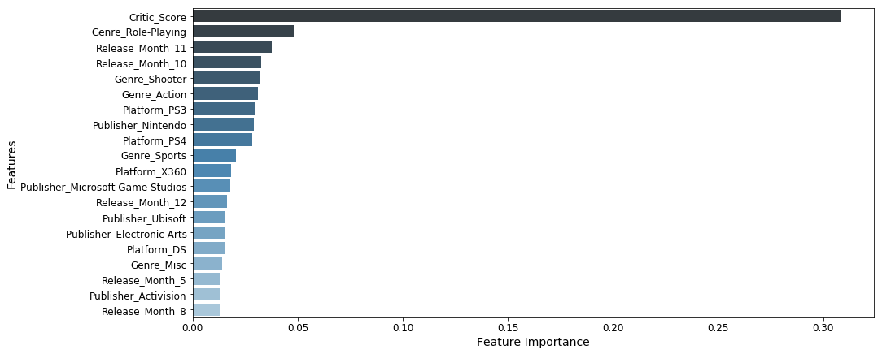
Important Features
Notes:
First Week sales have a ridiculously strong effect on the prediction outcomes.
Quite obvious, not very meaningful for the business problem.

Slide 25
5.
Evaluating Models
Notes:
Coz I could predict success based on first week sales data alone
Not to mention it’s not too helpful from the business case point of view.

Slide 26
5. Evaluating Models
Accuracy
Accuracy Scores:
Baseline
Predict all 0s
85.9%
Logistic Regression
85.5%
Random Forest Classifier
87.8%
XGBoost
90.1%
Notes:
Accuracy is simply how many results we got correct
COMMENTS: WHATS THE BASELINE

Slide 27
Accuracy
Not good due to imbalanced data:
15% classified as ‘1’ in training set.
More important to predict ‘1’s than ‘0’s correctly.
Notes:
Explain Precision and Recall
From the context of a game seller

Slide 28
Precision and Recall
Predicted Positive
Actual Positive
Precision
True Positive
Predicted Positive
Recall
True Positive
Actual Positive
True Positive
Predicted
=
Actual
All Data Points
Notes:
Explain Precision and Recall
From the context of a game seller

Slide 29
Precision and Recall
Precision: How many predicted successful video games are correct?
Recall: How many truly successful games are predicted by the model?
Notes:
Explain Precision and Recall
From the context of a game seller

Slide 30
5. Evaluating Models
Precision and Recall
Logistic Regression
Low Precision
43%
Low Recall
10%
Random Forest Classifier
OK Precision
60%
Low Recall
40%.
XGBoost
Best Precision
76%
Low Recall
43%
Notes:
Out of the 3 models, XGBoost performed the best.
Precision is 76%, Recall is still low at 43%

Slide 31
Insights

Slide 32
Insights
Critic Scores affects game sales the most.
Other important features include:
Release Month in October or November
Genre: Role-Playing, Shooter or Action
Publisher: Nintendo
Platform: PS4
Model favors Precision over Recall.
Notes:
Critic Scores could be important due to generating hype for the game
Release month: just prior to holiday season
Nintendo: biggest publisher, if we want to get our games out, get Nintendo licensing deals.
Platform: PS4. As of now, google says SOny Playstation outsells Xbox
Model favors precision. If we use this model, game stores less likely to sell unsuccessful games, but will miss out on a lot of successful titles.

Slide 33
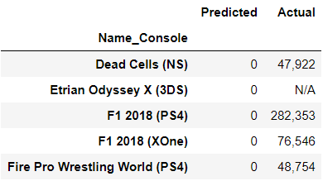
Bonus Round!
Predictions for games released before Sep 2018

Slide 34
